Slide 1
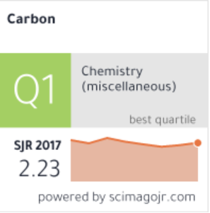
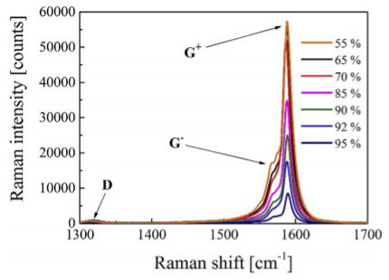
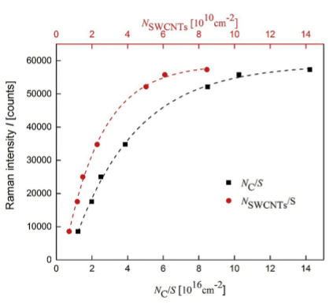
Scope of the study This study proposes a new technique for measuring the number of single walled carbon nanotubes (SWCNTs) and their concentration in a carbon nanotube layer is developed in the work. It is based on the G peak intensity of the Raman spectrum, together with precise mass and optical absorbance measurements.. Samples The 11 mm diameter samples of single walled carbon nanotubes (SWCNT) were used for the Raman spectroscopy. Process and Findings Exponential dependence of the concentration of sp2 carbon atoms/nanotubes on the G peak intensity of the Raman signal is obtained. That means that the number of the sp2 carbon atoms and nanotubes are proportional to the Raman signal intensity. The total mass and carbon content measurement allows to estimate the number of carbon atoms in the layer but it has accuracy and sensitivity limitations. Application This method opens an opportunity of the quantity mapping of sp2 carbon atom distribution in the SWCNT layers with a resolution limited the focused laser spot size.
Single walled carbon nanotube quantification method employing the Raman signal intensity
*All the images and information have been taken from the original paper for scholar purposes.

